Slide 1



2026 SUN CONFERENCE
Reduce customizations and make them uplift safe during upgrade
Presented by:
Jack Horst
CNH Reman
jhorst@cnhreman.com
1

Slide 2


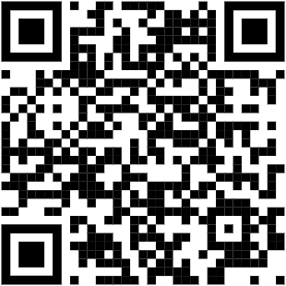
Introduction
Jack Horst
Software Development Supervisor
Message me with questions!
Fun Facts! 🎈
Been coding for SL for 13 years! 🍀
Started on 8.03.11
Led or helped lead 3 implementations
Upgraded two companies to V10
Integrated SyteLine with many external systems.
2
https://www.linkedin.com/in/jack-horst-46200463/
Notes:
Introduce yourself.
I am an experienced software developer.
I have been coding since I got near a keyboard for the first time.
By SyteLine journey started in 2013 on v8.03.11.
13 years – lucky number 13
I have led 3 SyteLine implementations bringing different acquisitions into SyteLine ERP.
I have led two upgrade projects one in 2020 at the heart covid from 8 to 10
The other in 23-24 from 9 to 10.
Feel free to take a picture and message me on LinkedIn with questions if you have any.
Before we start lets do a show of hands.
Who is on 9?
Who is on 8?
Who is thinking about or planning to upgrade to 10? (cloud or on prem)

Slide 3

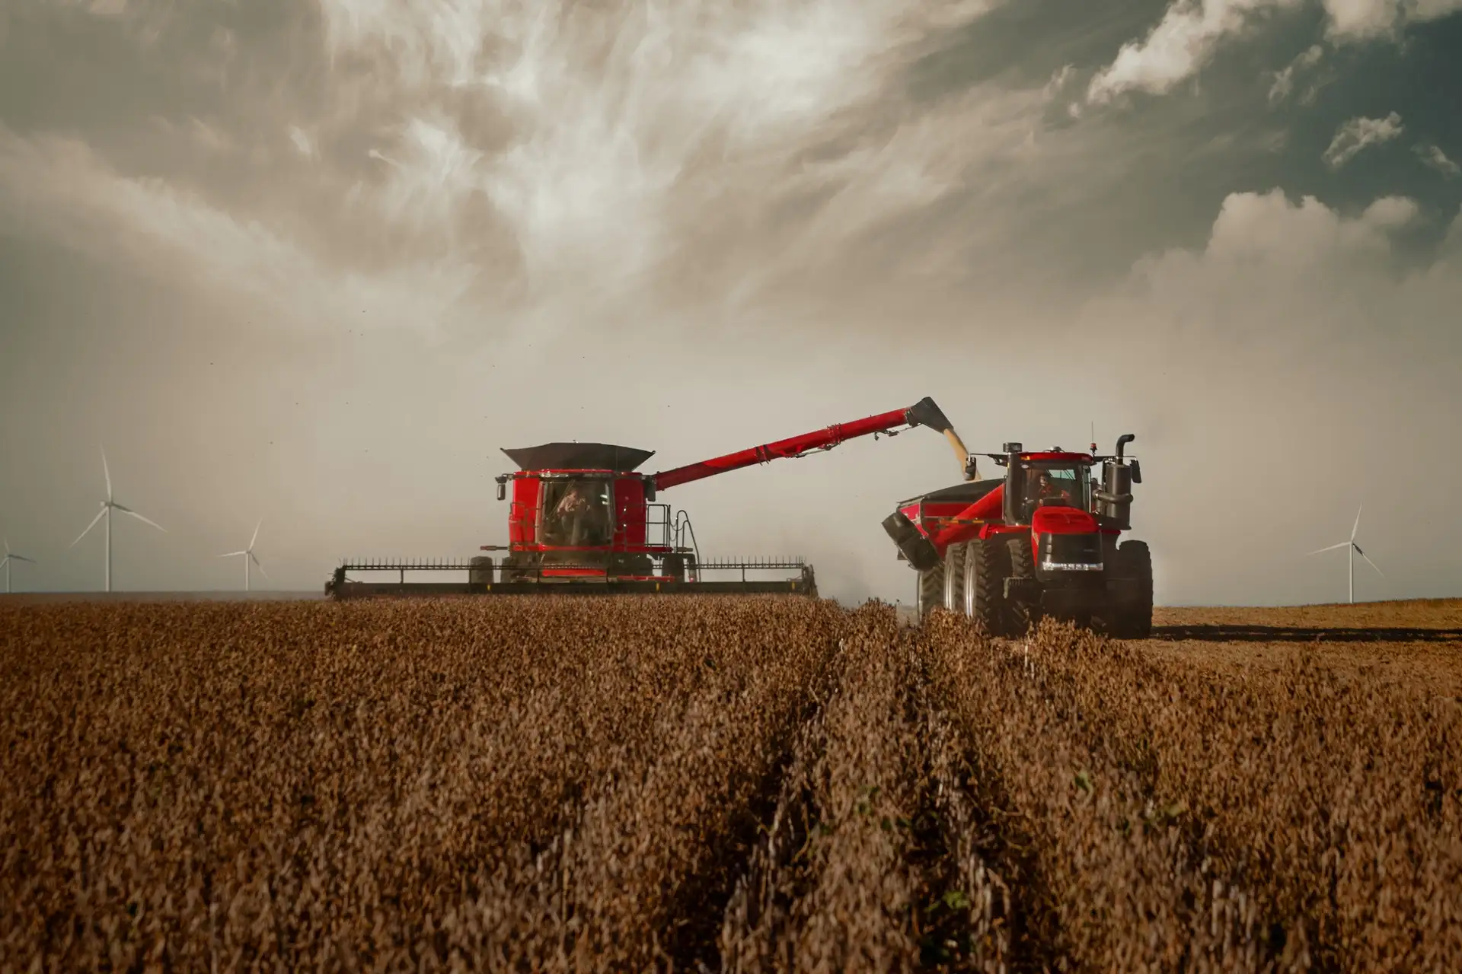

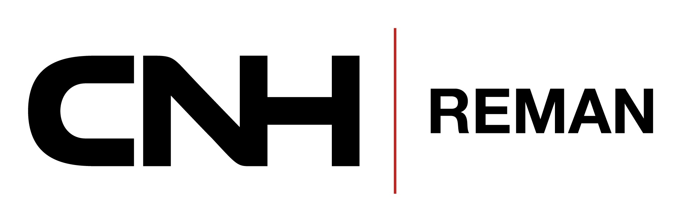
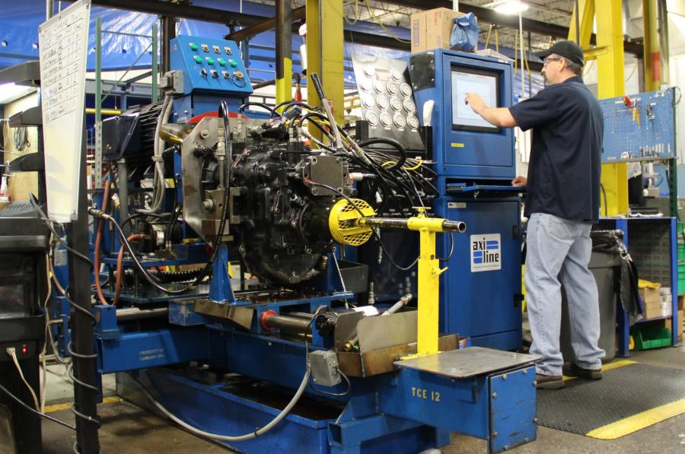
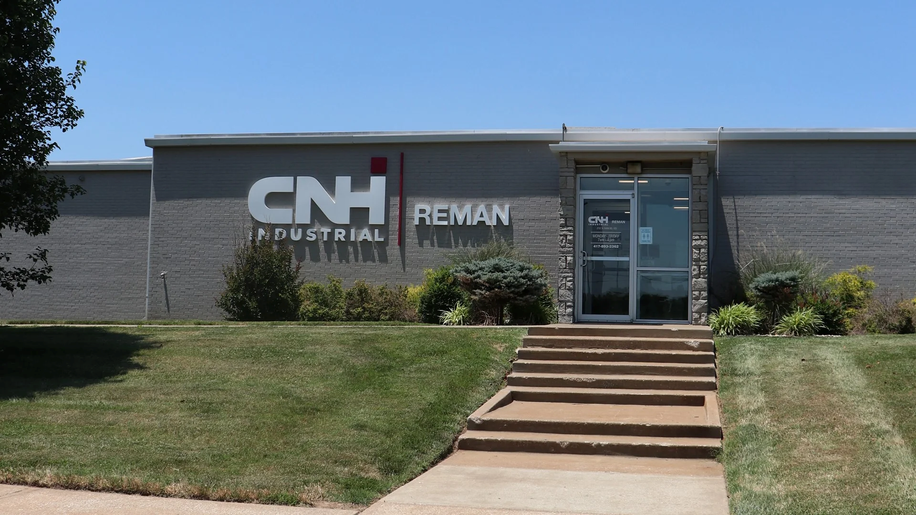
CNH Reman
+
=
3
Notes:
We are a Joint Venture between SRC (springfield reman company) and CNH (case new holand)
Now that I know what versions you're on let me get a bit of information out of the way about my company.
I work for CNH Reman. We are a child company of SRC and CNH.
CNH is one of the leaders in AG and other markets. SRC I would like to say is a leader in remanufacturing.
Together we make sure that farmers are positioned well and more equipment is running longer.

Slide 4

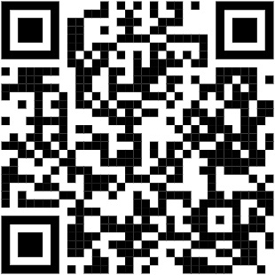
What are we here for?
Upgrading to V10!
Focus On:
Finding customizations!
Moving customizations!
Testing customizations!
Docs + Code Here 🧑‍💻
4 Problems!
4
https://github.com/CNH-Industrial-Reman/SUN2026
Notes:
I will be talking about CNH Reman’s upgrade.
But an upgrade is a big topic.
I could do a whole presentations on:
How to upgrade the software yourself.
How to form good teams of SMEs and get business buy in.
How to vet and test the systems.
Or even how to leverage source control to your advantage.
But we have 30 minutes.
So I will hone us in on our greatest challenges/hurdles
- How we overcame those challenges.
Now will be a great time to take a picture. This QR code will take you to materials I have gathered around upgrades and the tools we have written on our company GitHub page.
I will make source code and executables available to you for free with the hopes it helps you on your upgrade journey.

Slide 5

Important to know!
Support from the top.
Team of SMEs. (50% of their time)
Audit Log – find not used in 2 years.
Ran upgrade ourselves.
Stayed on prem.
SME = Subject Matter Expert
5
Notes:
It is hard to illustrate how important it is to an upgrade to have the company’s full support.
Directors provided us support. SMEs were picked and provided a large amount of there time/support.
We leveraged Audit Log to do things like identify what forms were opened in 2 years.
We decided to perform the upgrade ourselves and be on prem.

Slide 6
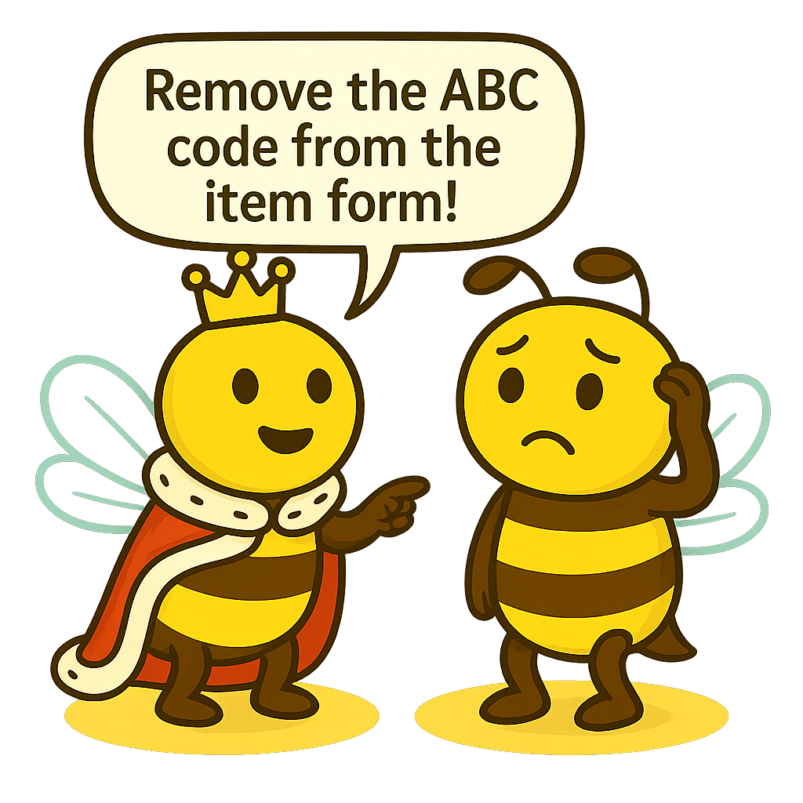
Finding Customizations!
Problem 1! 🫣
If SMEs have never seen stock SyteLine how do they know what is custom???
Sitting with them and reviewing didn’t scale!
We were in royal trouble!
6
Notes:
Recap:
We have formed the SME teams. Gotten top down commitment. (50% of there time)
We have trained the developers. Infor training and cross training within the team.
We have removed custom forms not opened in 2 years.
Now we need the SMEs to tell us what customization fields can be removed.
{Tell story of SME who asked for ABC code to be removed.}
When I worked on the upgrade from 8 to 10 in 2020 we started by having virtual meetings with the SMEs. We met with a list of custom components on forms and tried going through them one by one. But this took hours. It also eventually led to the SME getting frustrated. They started listed in order which fields to remove and included stock SyteLine fields. Most notably they demanded I remove the ABC code field. I then had to convince them of its importance and explain it isn’t custom.
We had hundreds of forms to clean up. We lost most of a day on one form. This process wasn’t going to scale. I needed a solution that would let the business go and come back with what needs to be removed.

Slide 7

Finding Customizations!
Problem 1! - Eureka Moment!
Solution came in the night!
Visual is better!
If we can give the SME an easy visual way
to see what is custom they can tell us!
7
Notes:
{Story Continued}
To keep SMEs on track and make it easier we just needed highlight visually what is custom.
Yellow, Blue, and Green were used by the system. Red seemed too angry. Negative feeling.
So, I wrote a script to make all customizations on the items form highlighted purple.

Slide 8
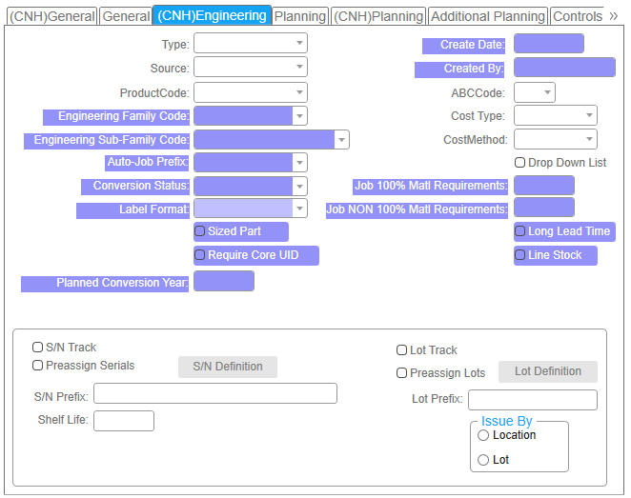

Finding Customizations!
Problem 1! – Solved!
Purple Field Analysis
Internally developed tool.
.NET 8 C# WPF Application
Compares Vendors to Site and creates Group level scripts.
Custom fields are purple and easy to review by SME!
8
Notes:
{Story Continued}
One off script went very well. SMEs were able to log into the system and identify what purple fields to keep or remove.
No more getting stuck!
Turn around was significantly quicker and less false positives. SMEs could review the purple fields with data and how they worked on the form live.
So, I wrote an application that generated purple field scripts. They made group level forms. So, users could go in and out of purple field mode.

Slide 9

Finding Customizations!
Problem 2! 😩
What about the hidden customizations?!?
Not everything can be purple after all.
How custom is a form really?
9
Notes:
Recap:
Okay so now we knew what purple fields we could remove and so we did. This helped remove many depended customizations too. Like UETs, form script, etc.
But now we needed to know about the changes that were not easy to see. Events, form script changes, component property changes etc.

Slide 10
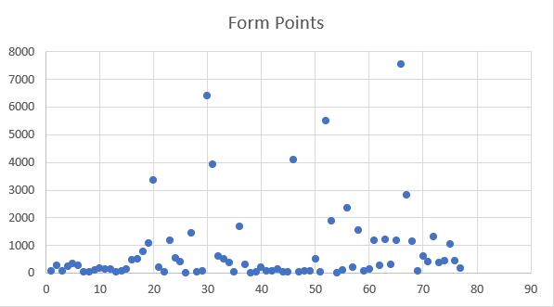
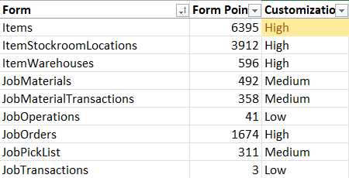
Finding Customizations!
Problem 2! – Solved!
Wrote a report! (Excel Dump)
Export per form
Type of customization
Information about the
customization
Scored by type and sum them up!
10
Notes:
I turned to the same method as last time. Write a tool.
I wrote a .NET 8 WPF application that would export to excel all of the site customizations on forms and categorize the customization.
Once in excel I used VLOOKUP to provide weights by type. Then summing the weights in excel gave me the score on how custom the forms were!
The review of the customizations and determining if the customization was needed was done by the developers.
They would review, excluding customizations needed by purple fields and get SME direction on the remaining customizations.
We were able to focus on forms with low scores first and were able to restore many of them to vendor level.

Slide 11
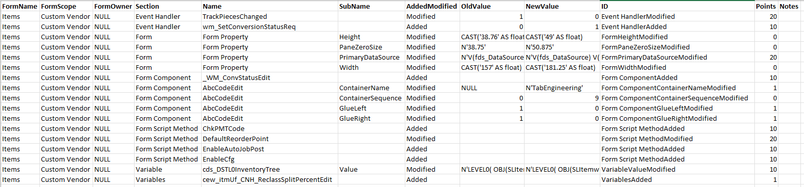
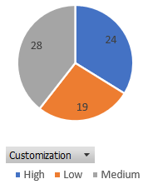
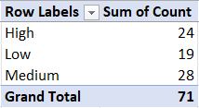
Finding Customizations!
Most Custom = Items 🏆
11
Notes:
This is what the report results look like. You can see it allows for clean filterable review of the customizations.
Item was our most custom with a score of 6395.
even split between forms with high, medium, and low levels of customization.

Slide 12
Finding Customizations!
712 – Site Level Forms
204 – Came from SyteLine
508 – Came from us
133 – Back to Vendor
335 – Deleted
65% Back to Vendor
66% Deleted
Important: 🚨
This doesn’t consider forms which are less custom but still customized.
12
Notes:
This is what the report results look like. You can see it allows for clean filterable review of the customizations.
Item was our most custom with a score of 6395.
even split between forms with high, medium, and low levels of customization.
Incase they ask. Yes

Slide 13

Moving Customizations!
Problem 3! 😨
We had 71 forms to customize in V10.
We had 173 forms to migrate to V10.
We needed version control!
Human error was a serious risk!
13
Notes:
Recap:
So now we have v9 as lean as we could make it. The SMEs can take a short break.
Now the IT team needed to migrate the customizations that the business approved to keep!
The issue was time and if the customizations would move over quickly with the least amount of human error.
We had a big issue.

Slide 14

Moving Customizations!
Problem 3! – Solution Delta Scripts!
Make SQL that is only customizations!
Moves quickly from version to version
Very easy to read in version control.
We can apply during the upgrade.
14
Notes:
The solution ended up being in the same theme as the last two issues.
We had been separating the customizations from site by removing the vendor.
With purple we highlighted them.
With the report we exported them to excel.
The next logical step was to create FormSync style SQL scripts that only contained the customizations.

Slide 15
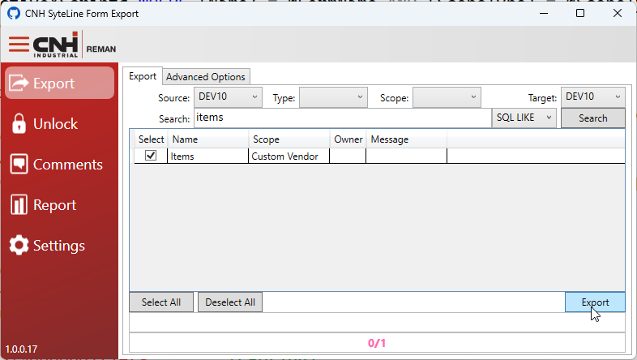
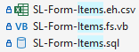
Moving Customizations!
Internally developed tool.
.NET 8 C# WPF Application
Generates an SQL file per form.
Form script in own file for VC
Event Handler in own file for VC
15
Notes:
I created an application and looped in the other two tools already made.
The “SyteLine Form Export” allowed the developers to quickly export the V9 customizations and move them to V10.
They then would check into GitHub the SQL > VB > and event handler CSV. Leaving an amazing trace in our version history.
This allowed us to move over night the majority of the customizations from V9 to V10.
We can also use them during uplifts to more safely weave back in our customizations after the uplift is complete and identify any customization damage during uplift.

Slide 16
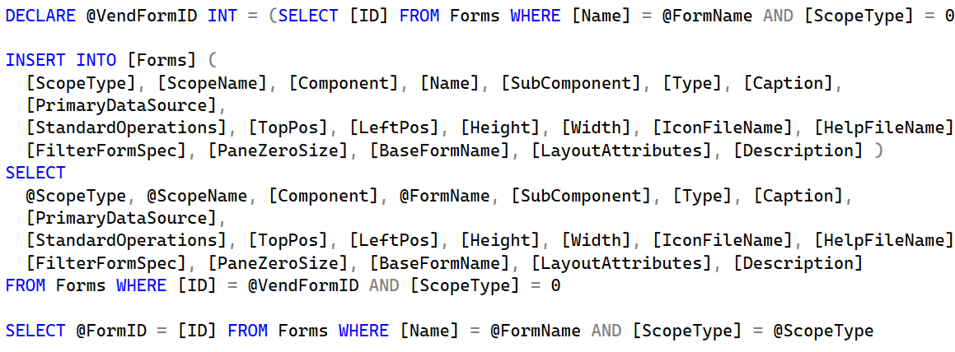
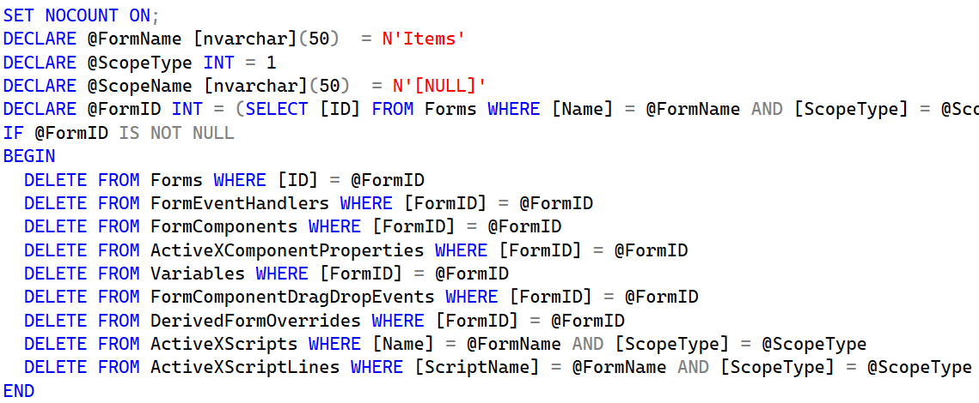
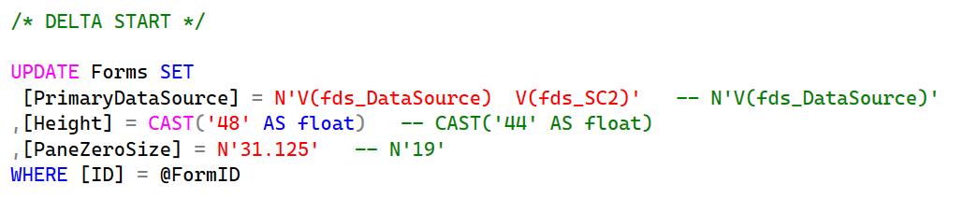
Moving Customizations!
How it works!
2
Copy the vendor to make the site
1
Delete the site level form.
3
Apply the customizations
16
Notes:
The tool generates the scripts in the following steps.
Delete the site level form from the DB.
Copy the vendor to make a site. (They are identical at this moment in time.)
Apply the customizations as updates and inserts. (As you can see the script also shows you what the vendor level form had.)
This has been helpful especially as we are moving changes from Dev to Test to make sure that only our customizations survive the migration.

Slide 17

Testing Customizations!
Problem 4! 🫣
We have the code moved but is it working in V10?
How can we get everyone engaged and testing?
We were in trouble!
17
Notes:
Recap!
We figured out what customizations needed moved to 10.
We figured out how to move our code from 9 to 10.
We had a great SME team.
We had commitments from the top. Over 50% of there time was to this project!
But we were not finding bugs! They had to exist! We knew we were not perfect. We didn’t want to find them in the first pilot.
We originally tried just asking SMEs to test their portions of the system. But some were engaged more than others.
Some were ignoring issues while others were reporting them. We were in trouble!

Slide 18
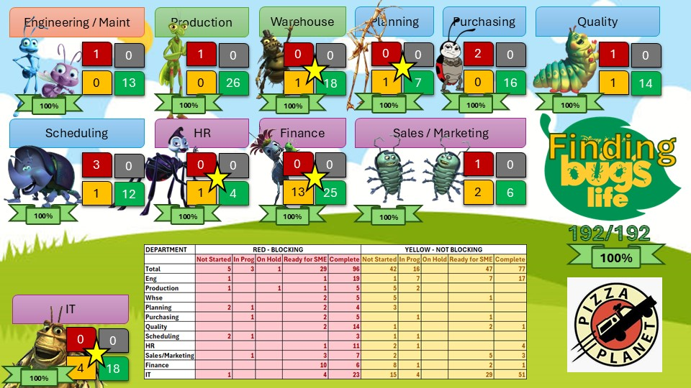

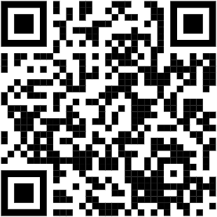
Testing Customizations!
18
Notes:
But luckily our company culture came in to help us.
You see SRC our parent company is a champion of the “Great Game of Business” by Jack Stack.
This open book culture at the heart of our company also has a handy tool for situations like this one. We made a MiniGame!
Gameified the problem.
To oversimplify MiniGames are when you identify an issue and make fixing the issue fun with a game. So, in this case we themed our game to bug’s life the movie from Pixar.
Each SME was in a competition to test their portions of the system ahead of the pilots. We had rewards for our minigame and the score of the game was updated and posted company wide.
Results showed on the TVs throughout the plant. This game resulted in a boost of engagement as SMEs competed to test there portions first. IT got engaged by resolving the bugs found displaying our progress on the same board. The game didn’t find all bugs but stabilized our system ahead of the first pilot.

Slide 19
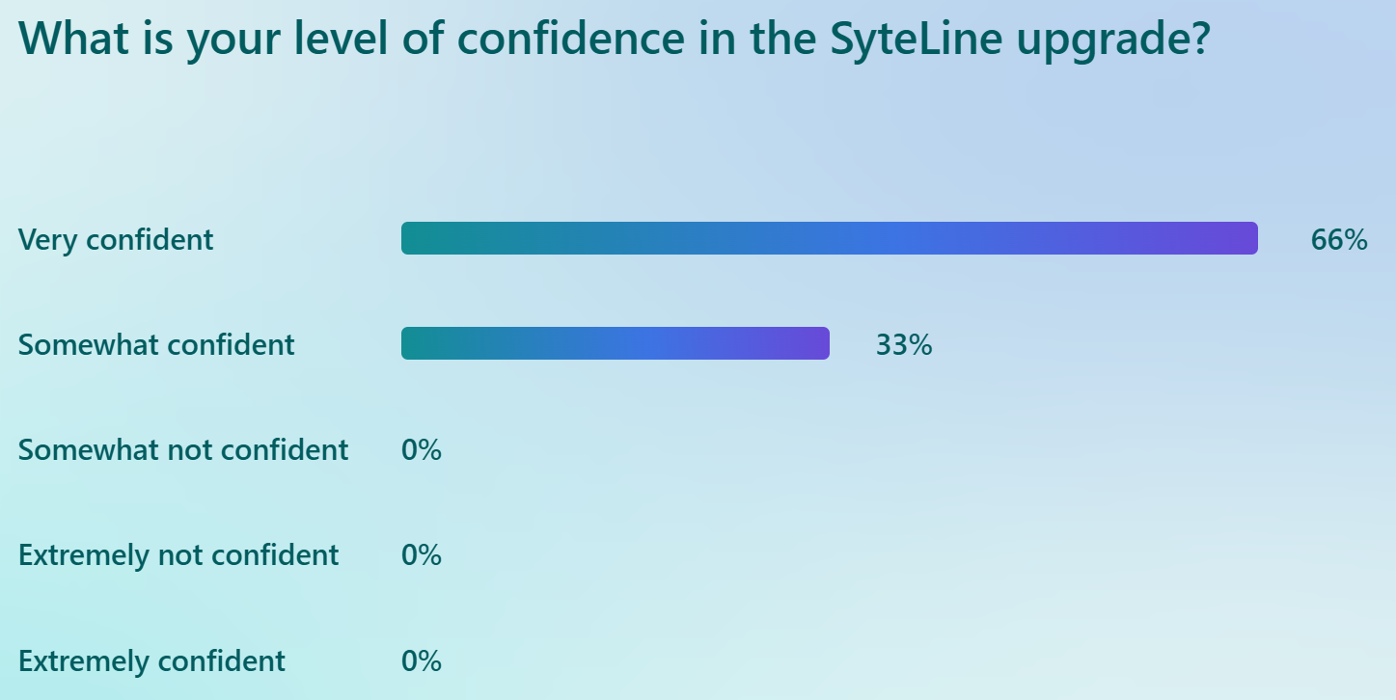
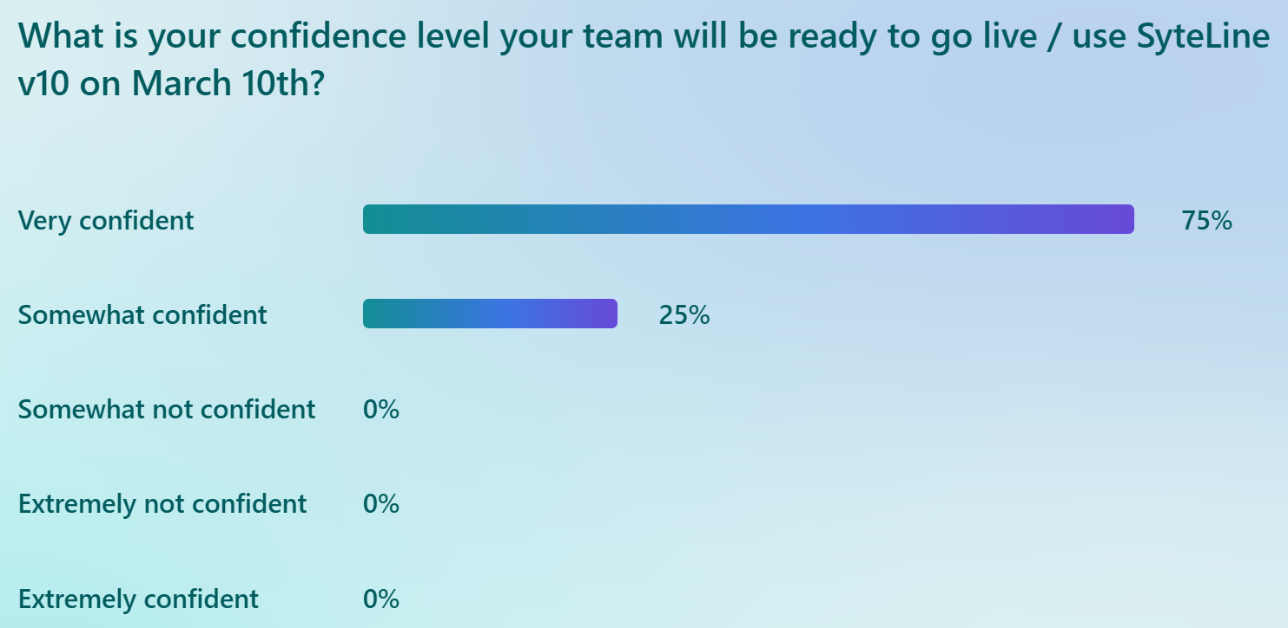
Pilots
Round 1: 72 Issues Found
Round 2: 45 Issues Found
Round 3: 23 Issues Found
Round 4: 11 Issues Found
Disclaimer: Does not contain feature requests or v9 bugs
19
Notes:
We had 4 separate pilots. Each one found less issues. On the last pilot the issues found were minor ones and non blocking.
The SMEs were polled and were charged with the giving the go no go for our upgrade. They gave us the green light and we went forward.

Slide 20
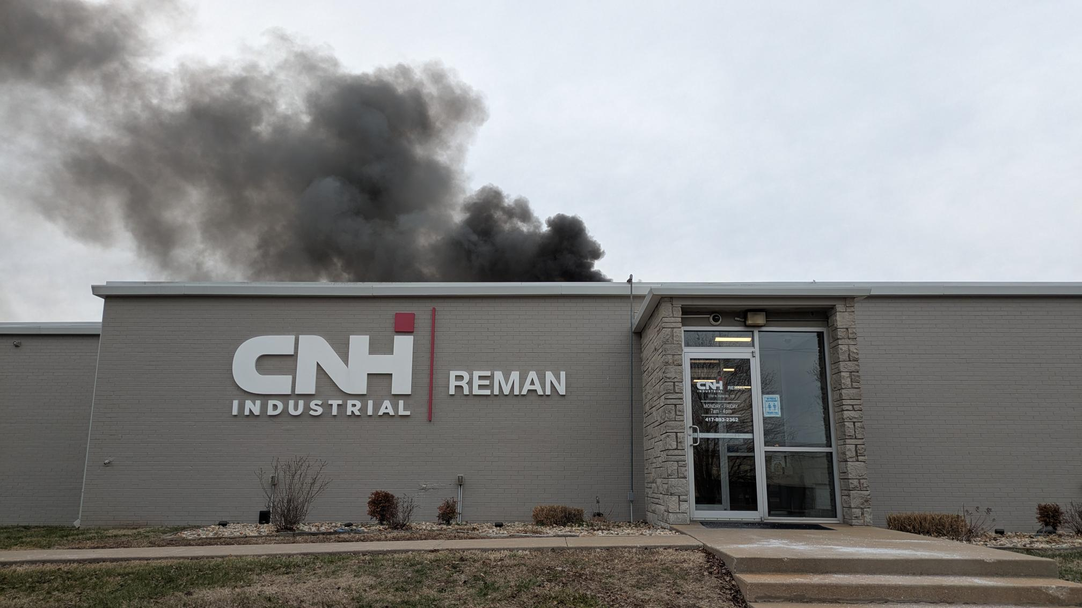
Presented by:
Jack Horst
CNH Reman
jhorst@cnhreman.com
QUESTIONS?
Jack’s
LinkedIn
Docs + Code
Here 🧑‍💻
20
Notes:
150k under budget

